Slide 1
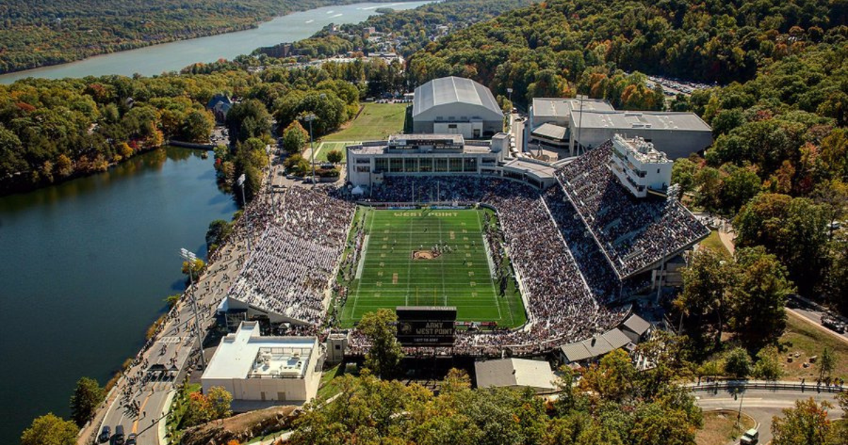
How well can College Football Games be Predicted?
A deep dive into the world of how sportsbooks predict college football games
by A.J. Grande

Slide 2
INTRODUCTION
Inspiration for this project and an intro to some key concepts
DATA QUESTIONS
What do I want to answer with this project?
Roadmap
FINDINGS
What did the data actually show?
CONCLUSION
What are the takeaways we can draw from this?

Slide 3
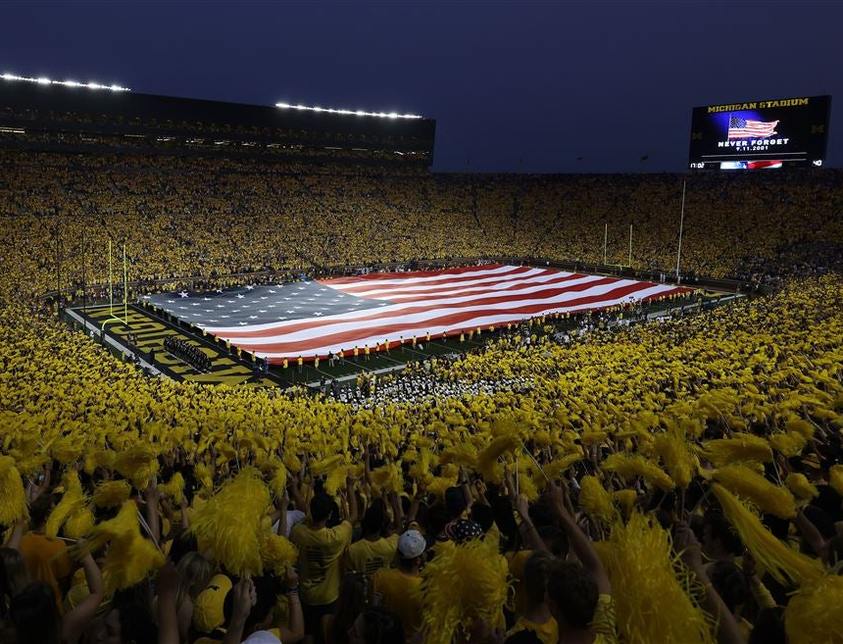

Introduction
Inspiration for this project and an intro to some key concepts

Slide 4

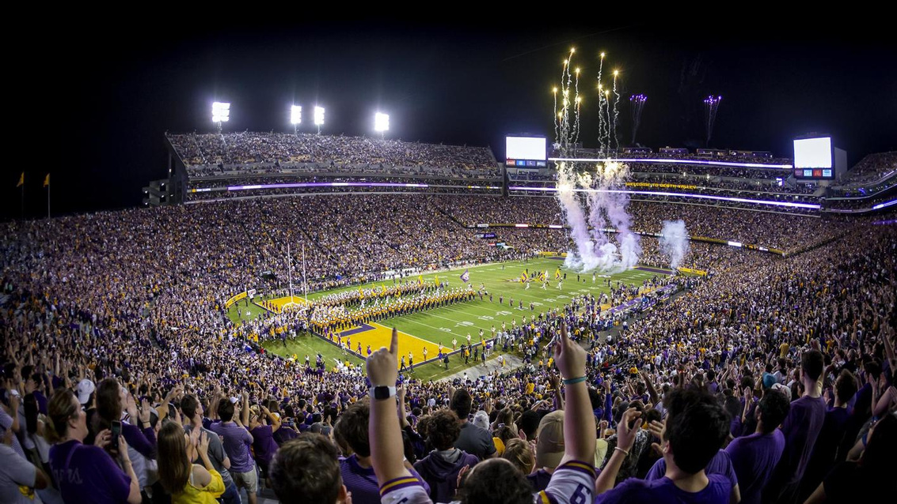
Inspiration
Why did I choose this topic?
Love of college football
Sports gambling became federally legal in 2018
Talked about more all of the time in media
Vegas knows more than you

Slide 5
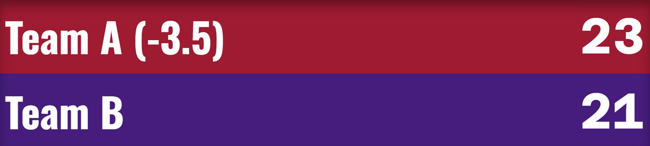
What is the Spread?
It is most easily explained with an example:
Team A is favored to win against Team B by 4 or more points
Team A's spread for the game would be -3.5 points, meaning their margin of victory must be 4 or more to cover their spread.
Team B's spread for the game would be +3.5 points, meaning their score must lose by less than 3 points or win the game to cover their spread.
For this example, let's say that Team A won the game by 2 points. Because their margin of victory does not cover the -3.5 spread set for them, the winning bet would be those who chose Team B +3.5 because they lost by less than 3.5.

Slide 6
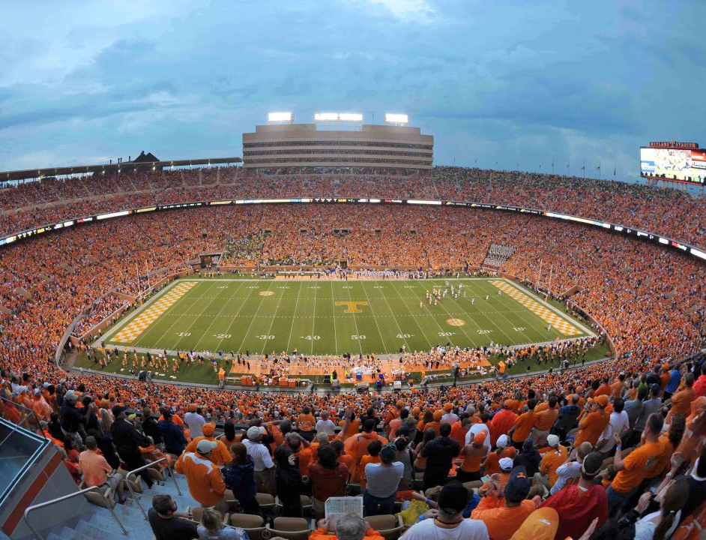
Data Questions
What do I want to answer with this project?

Slide 7


Accuracy
Trends
The spread is Las Vegas effectively predicting how much a team will win/lose by.
How often is Las Vegas close to predicting these outcomes?
What trends can we find in the data?
Are there certain teams or conferences they can best predict?

Slide 8
The Vegas Error
The spread can be a very difficult concept to grasp so let's make it a little easier to visualize for the purpose of measuring how accurate Las Vegas is:
The Vegas Error is the difference between the prediction and outcome to show how close Las Vegas was.
In this example, the final result was Team A only winning by 2 points, but they were favored to win by 3.5
That would make the Vegas Error on this game 1.5, which is incredibly accurate.
Zero is the goal of this metric
Anything within .5 is basically a perfect prediction, as the .5 on the spread is only there to prevent a case where there isn't a winner (push).

Slide 9
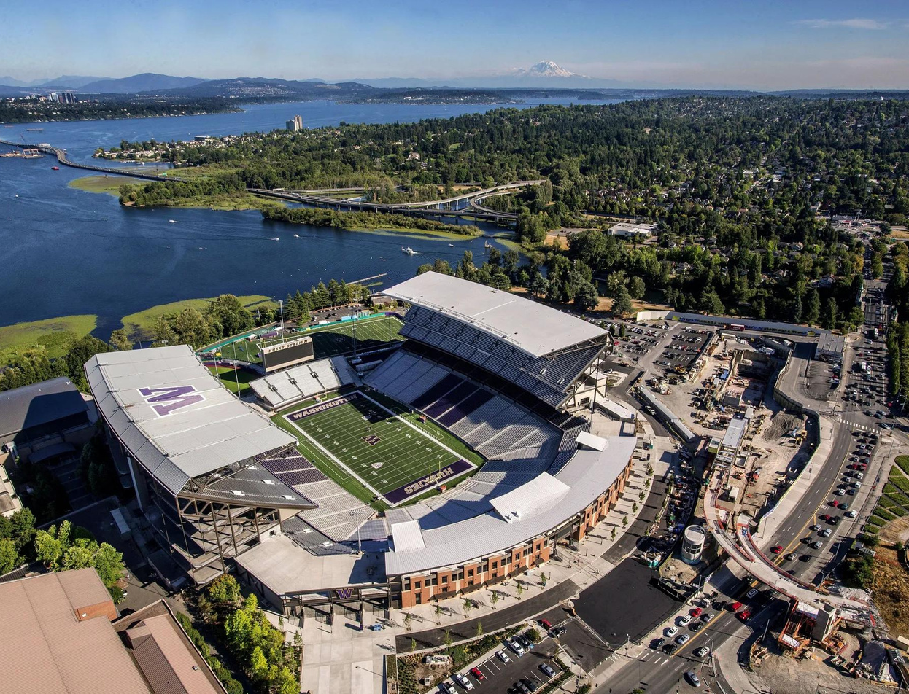
Findings
What did the data actually show?

Slide 10
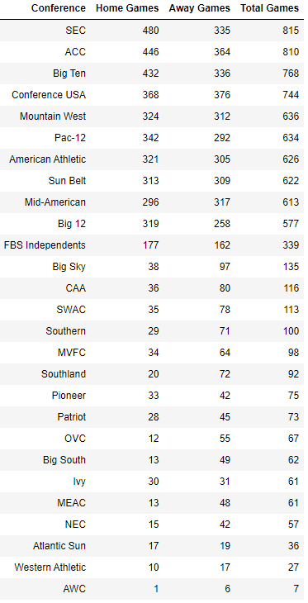
Some Basic Ground Rules
5 seasons of data, 2018 to 2022
Regular season games between 2 FBS teams only.
Teams of the top 10 conferences and independents
Very inconsistent data outside of that

Slide 11
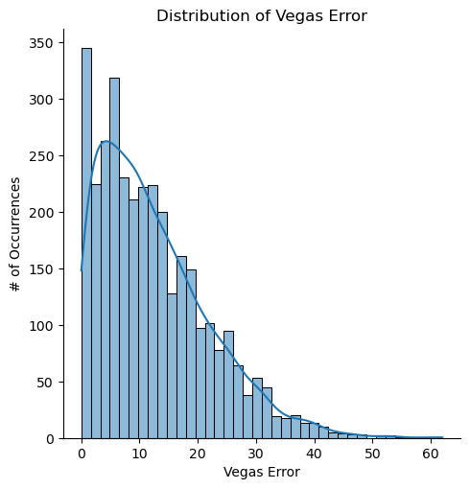
Details on the Vegas Error
Average Vegas Error: 12.4
Max Vegas Error: 62
25% percentile: 5
50% percentile (Median): 10.5
75% percentile: 17.5

Slide 12
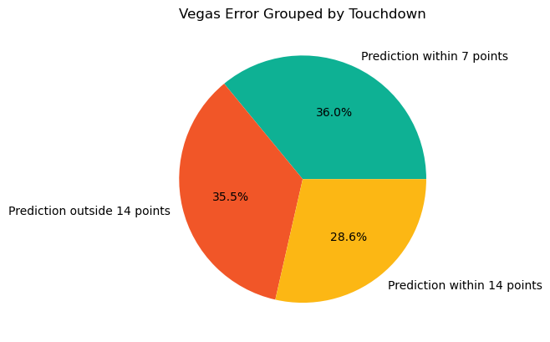
Put it in Football Terms

Slide 13
How Often was Las Vegas spot on?
4.8%
161 games out of 3365 games with “perfect” predictions
Vegas error was less than one (0 or 0.5)

Slide 14
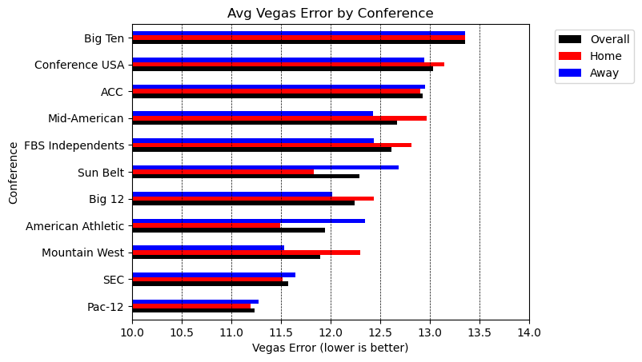

Slide 15
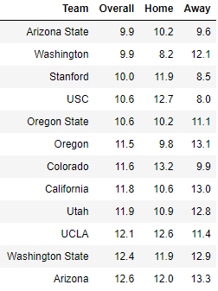
Pac-12 Average Vegas Error by Team
All but ONE team is at or below the Vegas Error average
No other conference had more than one.

Slide 16
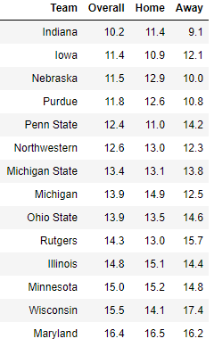
Big Ten Average Vegas Error by Team
Red teams were in top ten worst Vegas Error nationwide
No other conference had more than 1
9 total teams below average Vegas Error (12.4)

Slide 17


Other teams of note
Memphis had the lowest Vegas Error of only 8.5
Making them the team that was predicted most correctly
James Madison had the highest Vegas Error of 17.9
The newest team in FBS football

Slide 18
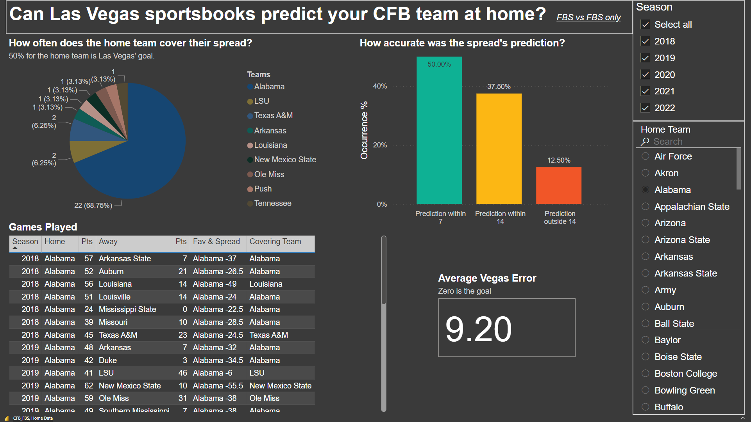

Slide 19
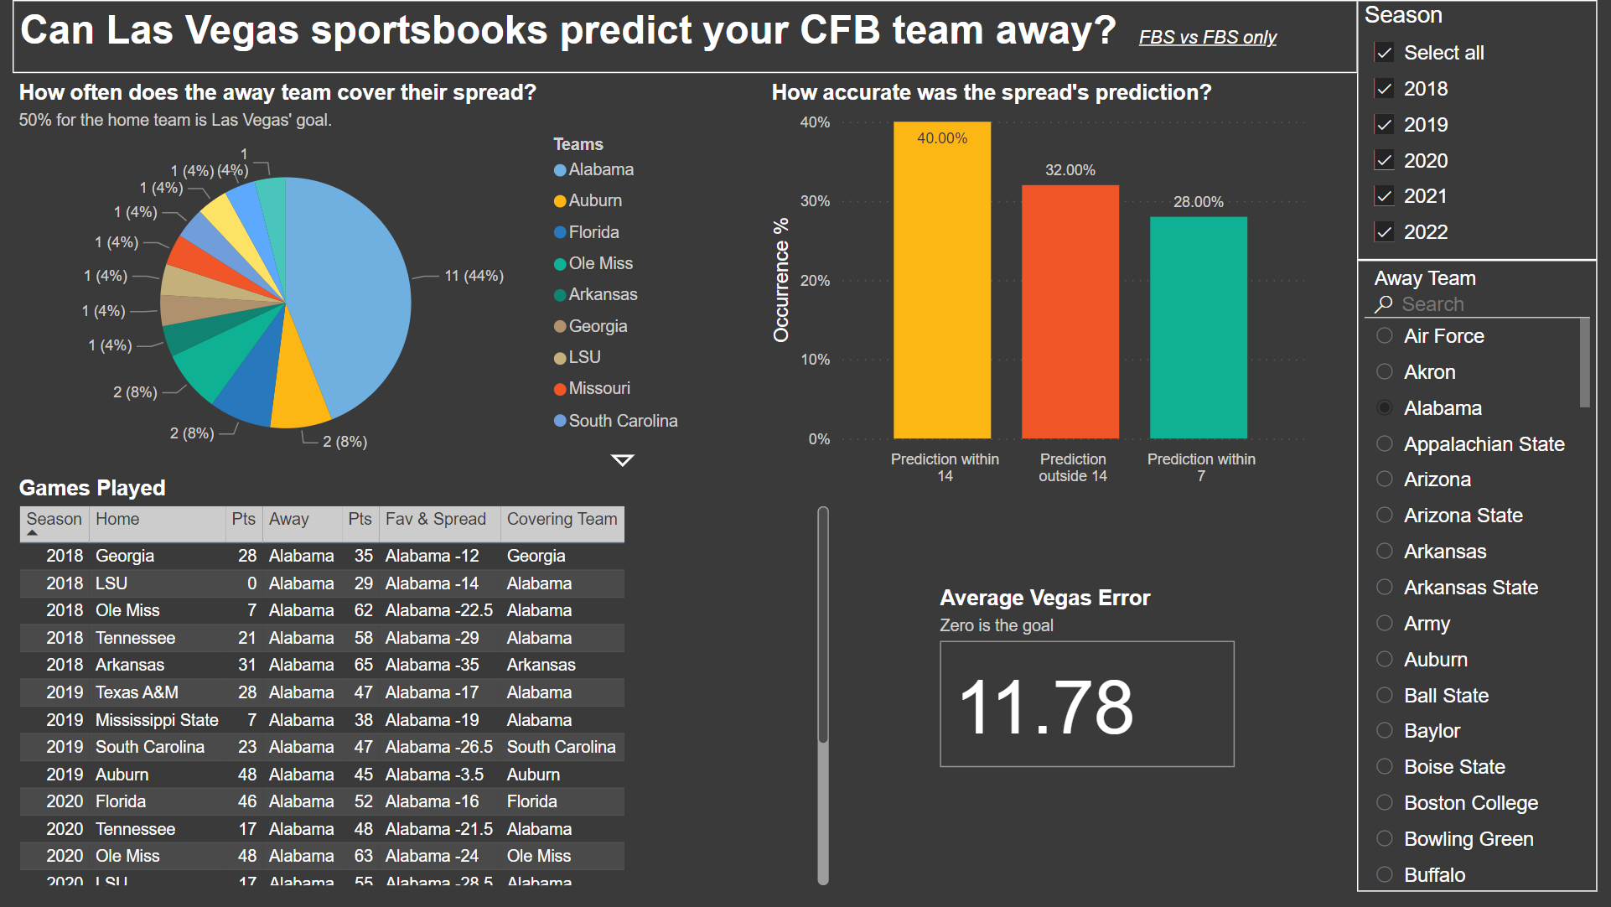

Slide 20
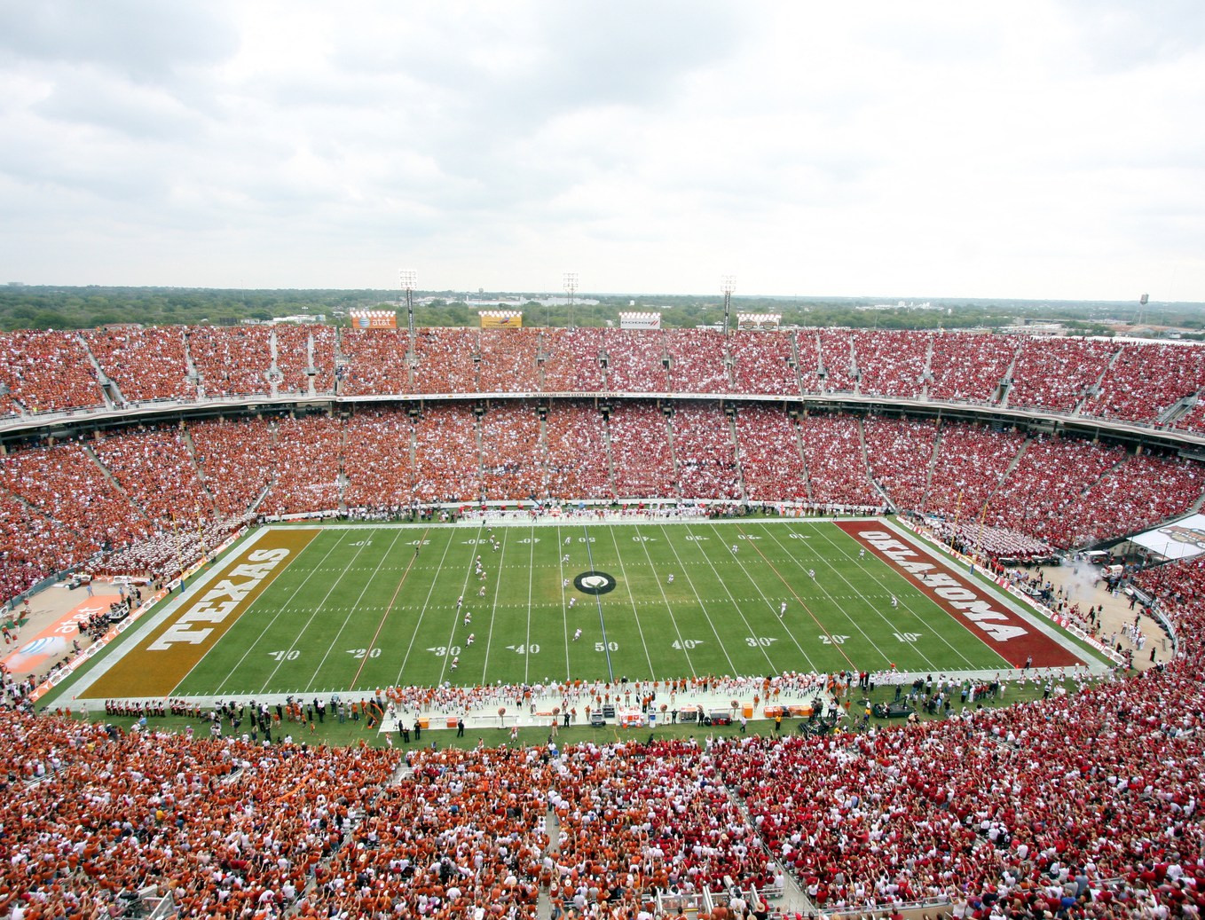
Conclusion
What are the takeaways we can draw from this?

Slide 21
Conclusion
Las Vegas’ spread is fairly accurate
Las Vegas is within two touchdowns almost 65% of the time
The most accurate predictions involved the conferences most covered in the media
The obvious outlier is the Big Ten, which falls into both extreme situations

Slide 22
Special thanks to Nashville Software School, especially the instructors of Data Analytics Part-Time Cohort 9.
Thanks for your time!
My DA9 classmates, I really enjoyed walking through this with you and helping each other along the way
Now time for a couple of shoutouts:
Collegefootballdata.com, for being a great resource to find all the data I needed to do this analysis

